Slide 1


API Based Self Service for Network Participant
V 2.0

Slide 2
Agenda
Scenarios considered
Stages in Subscription
Support
Implementation Approach and Important Dates
FAQs

Slide 3
Scenarios considered

Slide 4
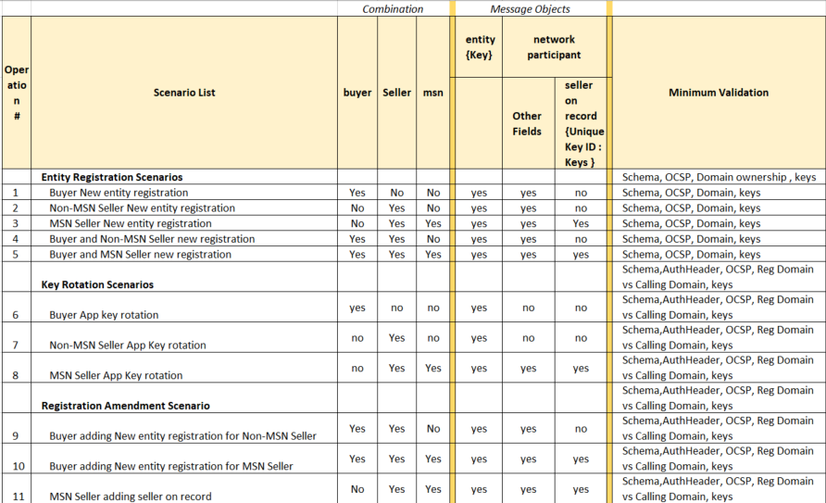
Scenarios

Slide 5

Minimum
BuyerApp
SellerApp (Non_MSN)
SellerApp (MSN)
Entity –
Network Participant
BuyerApp - Type
Domain-1
Entity – Subscriber ID
Network Participant
SellerApp - Type
Non-MSN
Domain-1
Entity – Subscriber ID
Network Participant
SellerApp - Type
MSN - true
Domain-1
Seller-on-record-1
Seller-on-record-n
Seller-on-record-2
Subscriber ID
Subscriber ID
Subscriber ID
sit.grab.in
bpp.dbs.digiit.ai
ondc.sellerapp.in
Subscriber_url
Subscriber_url
/bpp
Subscriber_url
/spp
/bapl
https://sit.grab.in/bapl
https://bpp.dbs.digiit.ai/spp
https://ondc.sellerapp.in/bpp

Slide 6
Maximum
Entity – Subscriber ID
Network Participant
BuyerApp - Type
SellerApp - Type
Non-MSN
MSN - true
Domain - retail
Seller-on-record(s)
Domain-logistics
BuyerApp - Type
SellerApp - Type
MSN - true
Seller-on-record(s)
Non-MSN
Assuming there are two domains active as on date in ONDC – retail and logistics

Slide 7
Validations/checks
At the time of entity registration
Domain Ownership
For all API Calls
Online Certificate Status Protocol
Key verification
Schema Validation
For all API calls after registration
Request initiated from Domain Vs Registered Domain Check

Slide 8
Stages in Subscription

Slide 9
Stage
Pre-requisite before calling /subscribe (Steps 1-5)
/subscribe
Registry calling /on_subscribe on Network participant hosted system
Active Network participant available in /lookup

Slide 10
Overall Steps involved : Stage A
subscriber_id: Buy or Register domain name.
SSL Certificate:
Purchase SSL Certificate with subscriber_id (Domain Name)
All communication with ONDC to happen from subscriber_id over SSL
Online Certificate Status Protocol check will be done for each request on the basis of SSL configured on subscriber_id
/on_subscribe : Develop and host it on subscriber_id (Domain Name)
signing_public_key, signing_private_key and encryption_public_key, encryption_private_key : Generate key pairs
request_id for Domain Ownership Check :
Create an request_id (ex. UUID)
Sign request_id using signing_private_key generated in step 4
Create “ondc-site-verification.html” and place it in root of subscriber_url by adding SIGNED_UNIQUE_REQ_ID
Registry shall check existence of ondc-site-verification.html at https://subscriber_id/ondc-site-verification.html

Slide 11
Overall Steps involved : Stage A (contd….)
Create “ondc-site-verification.html” and place it in root of subscriber_id

Slide 12
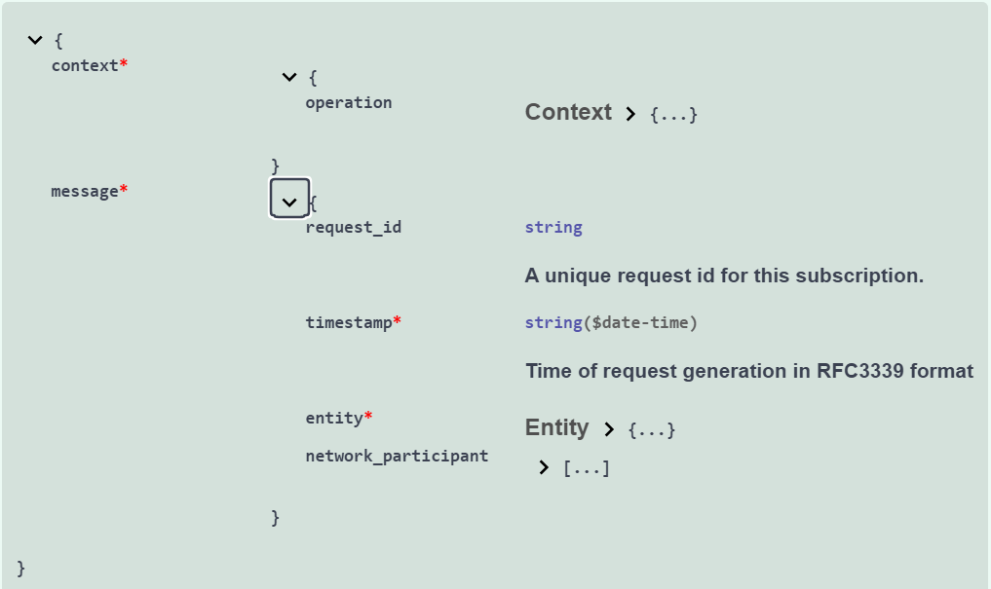
Overall Steps involved : Stage B
Call /subscribe

Slide 13
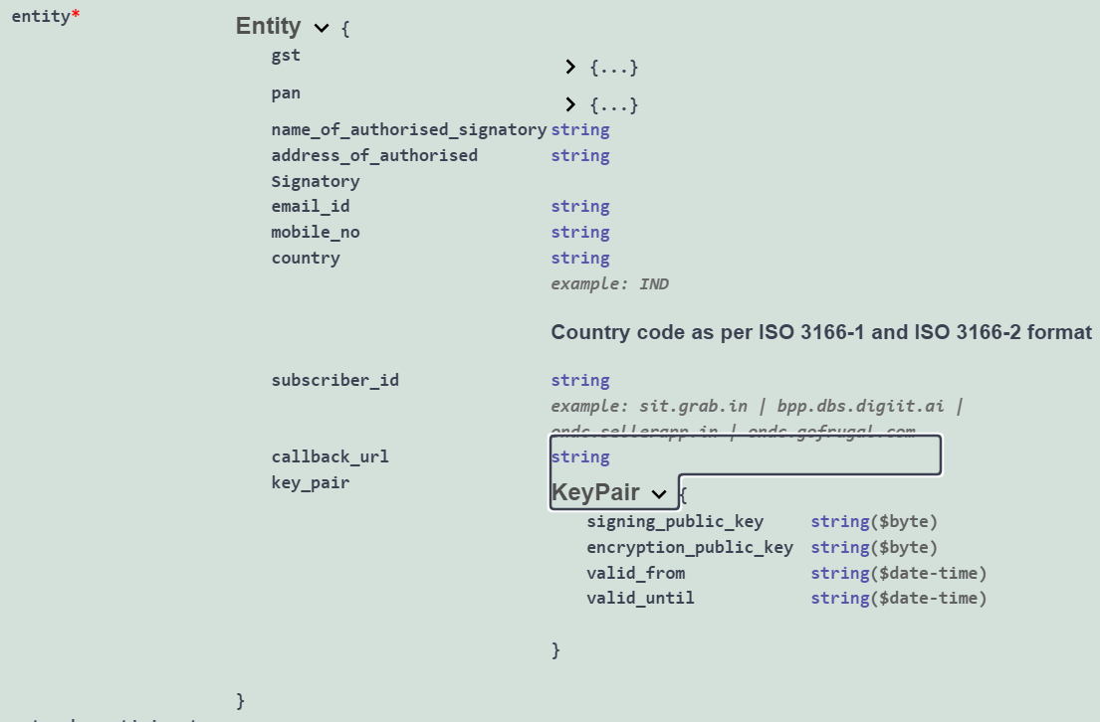
Overall Steps involved : Stage B (Contd…)
Call /subscribe

Slide 14
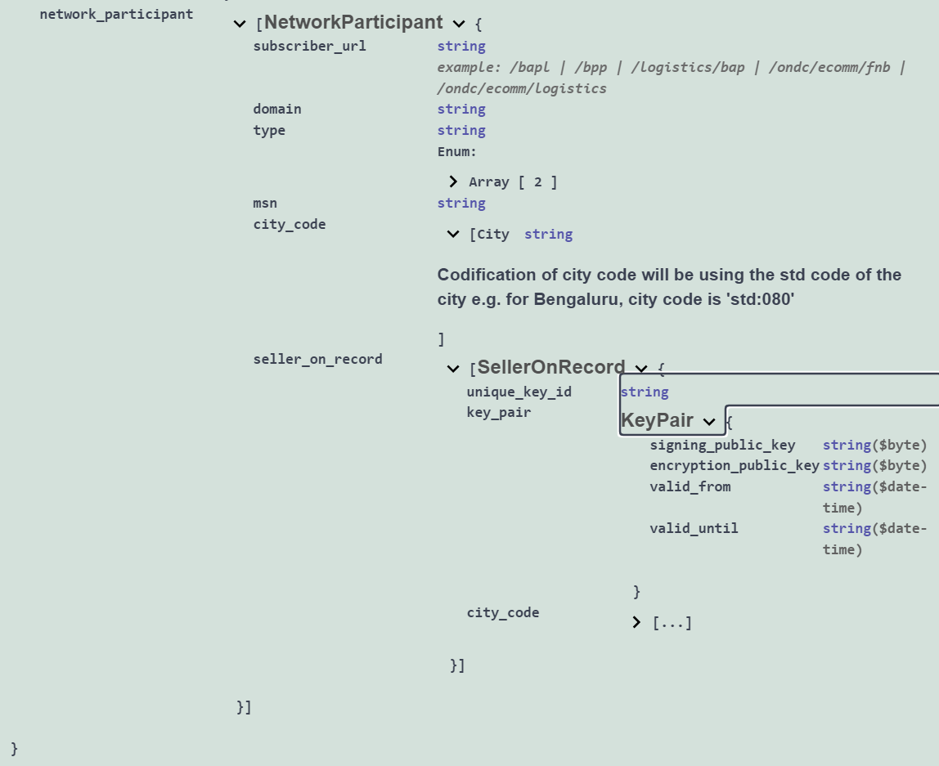
Overall Steps involved : Stage B (Contd…)
Call /subscribe

Slide 15


Registry calling /on_subscribe on Network participant hosted system : Stage C
Registry will use encryption_public_key to encrypt challenge string
Network participant need to use encryption_private_key to decrypt
Request
Response

Slide 16
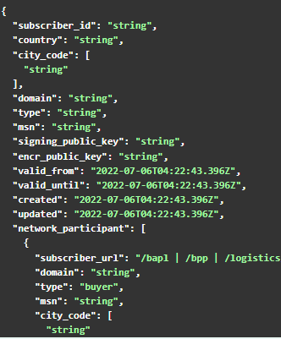
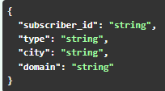
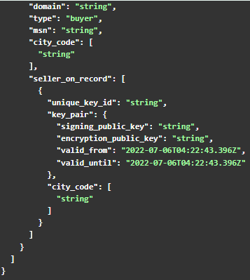
Active Network participant available in /lookup : Stage D
Request
Response
Authheader: Signed RequestBody
OCSP Check
Requested subscriber_id Vs Registered subscriber_id

Slide 17
Implementation Approach

Slide 18
Implementation Approach
Call with Network Participant
5th July
Pre-Prod on-boarding
8th Jul
Pre-Prod Review
11th Jul
Production Migration Data to be presented for review to ONDC in case if on-boarding is stable by 11th July

Slide 19
Support

Slide 20
Support
ONDC to create and share New JIRA Project for V2 Onbaording APIs
Protean Team to provide monitor and provide resolution from 0900 HRS to 2400 HRS
Daily dashboard publish of JIRA Issues by Protean Team to ONDC
Total Reported Issues
Severity wise
Open Issues
Closed Issues

Slide 21
FAQs

Slide 22
FAQs
As a network participant how do i create keys required for signing and encryption ?
Develop self
Is it ok to share signing private key and encryption private key ?
No, private keys needs to be kept confidential and secured by network participant. For example, make use of HSM
Why is ondc-site-verification.html required to be created and kept in root of subscriber_url ?
This is to verify ownership of domain that is used for calling APIs on ONDC.

Slide 23
Thank You

